Slide 1

Swinging Atwood Machine
Michael Kister & Alli Behr

Slide 2
What is Chaos?
The field in mathematics that studies the behavior of dynamical systems
Most things in physics are predictable, with clear linear, exponential, or quadratic behavior. Chaos theory examines the systems occurring in nature and man made mechanisms.
Chaos is Characterized by the butterfly effect.

Slide 3
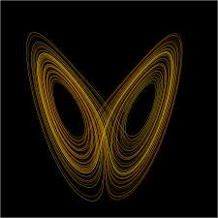
The Butterfly Effect
-The idea that a small change in one initial condition can cause a huge effect in the overall system.
-Demonstrated by the idea that the a single butterfly flapping his wings in one part of the world, can set off a chain of events that causes a hurricane on the other side of the world.

Slide 4
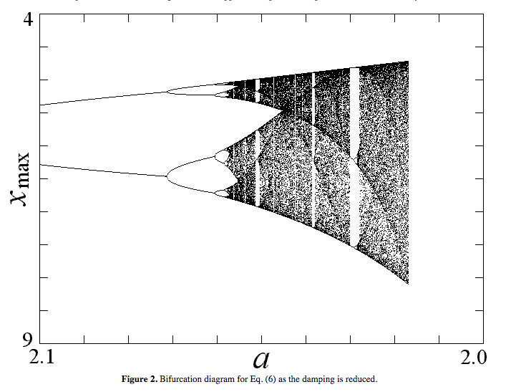
Bifurcation Diagrams
-Chaotic Systems are characterized by the idea that for some initial conditions, the behavior of the system follows a predictable path, but for others the state of the system falls into chaos, and it is impossible to predict the state of the system.
-Tradition bifurcation diagrams show how frequencies of simple systems can fall into complete chaos by varying a, in this case the damping of the system.

Slide 5
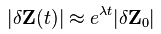
Lyapunov Exponent
- An Exponent that characterizes the rate of separation of infinitesimally close trajectories in a dynamical system.
-Gives an idea of the predictability of a system.
-Chaotic Systems have exponents between 0 and 1
-Plain English?
- Characterizes the rate of separation of the trajectories.

Slide 6
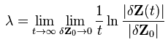
Finding Max Lyapunov
-The max Lyapunov exponent will characterize the chaotic behavior of the system.
-Still working out code to find it.

Slide 7
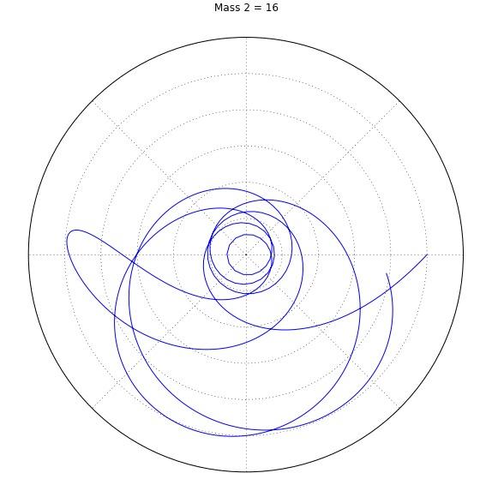
What is dZ(t)?
-dZ(t) is used to find change in change in trajectory.
-measures how fast the orbits are diverging
dZ(t)
dZ₀

Slide 8
Swinging Atwood Machine
m
M

Slide 9
Hamiltonian Approach

Slide 10
Hamiltonian Approach

Slide 11
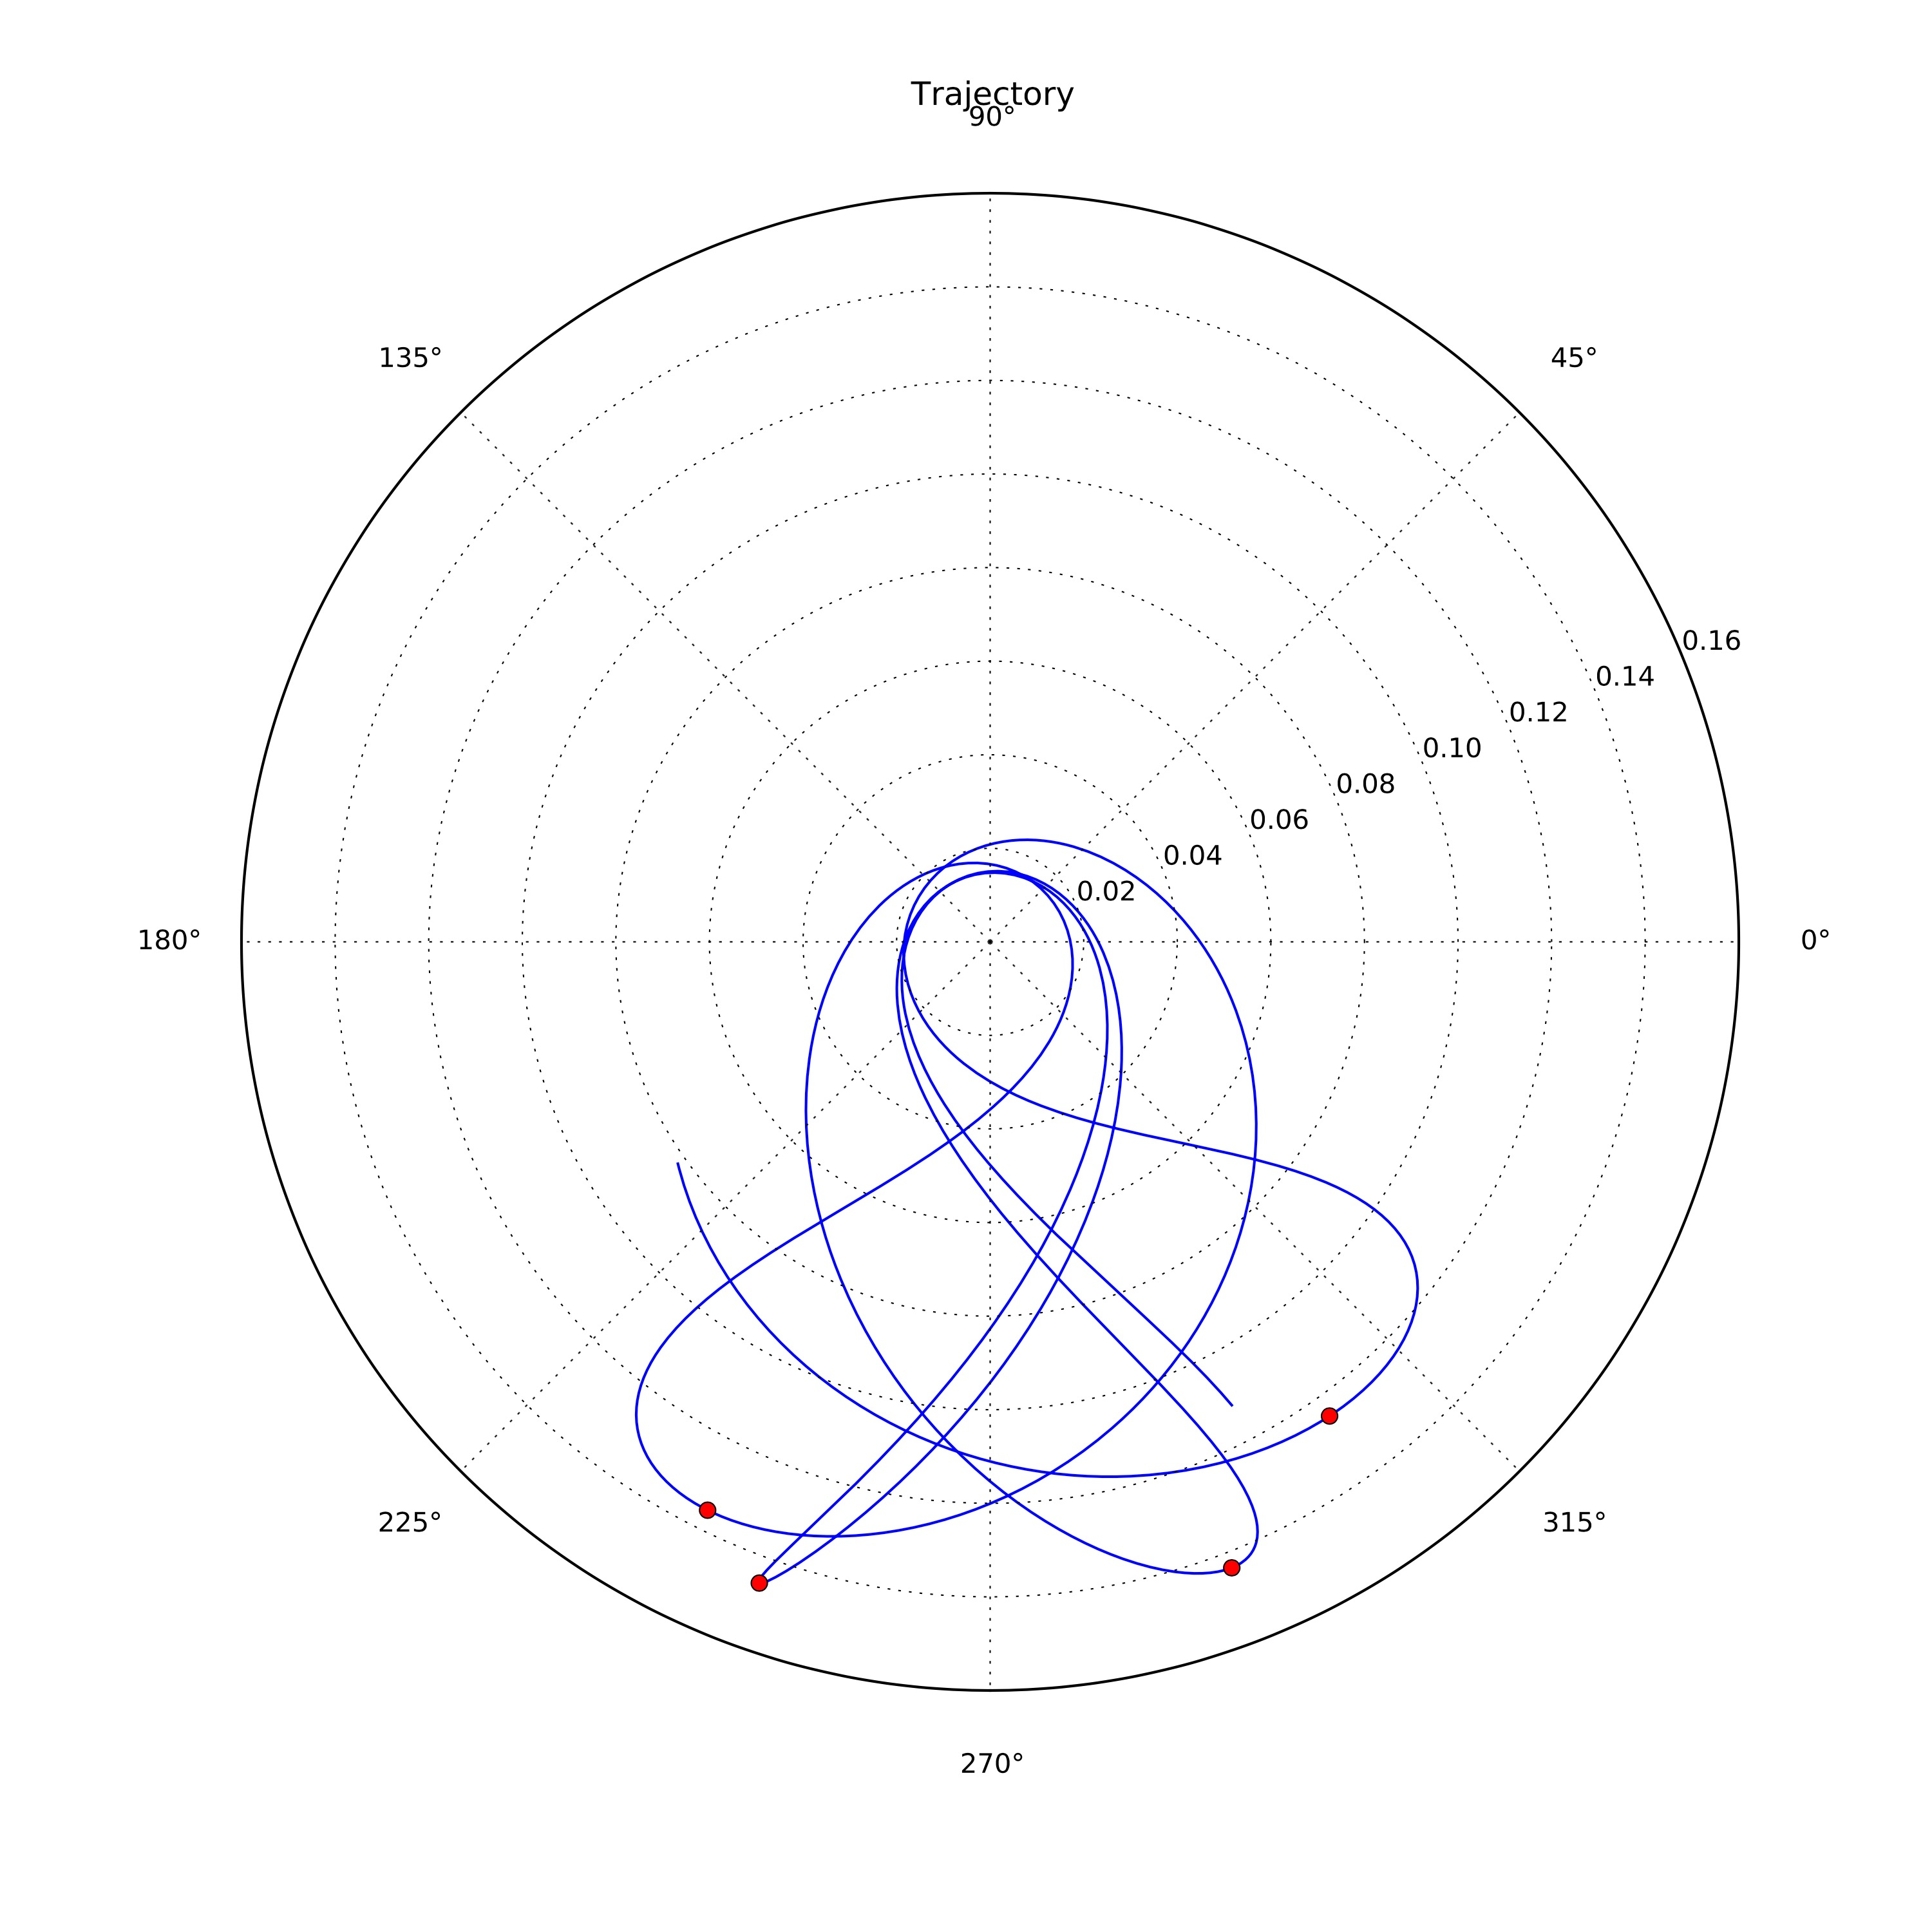
Bifurcation Diagram

Slide 12
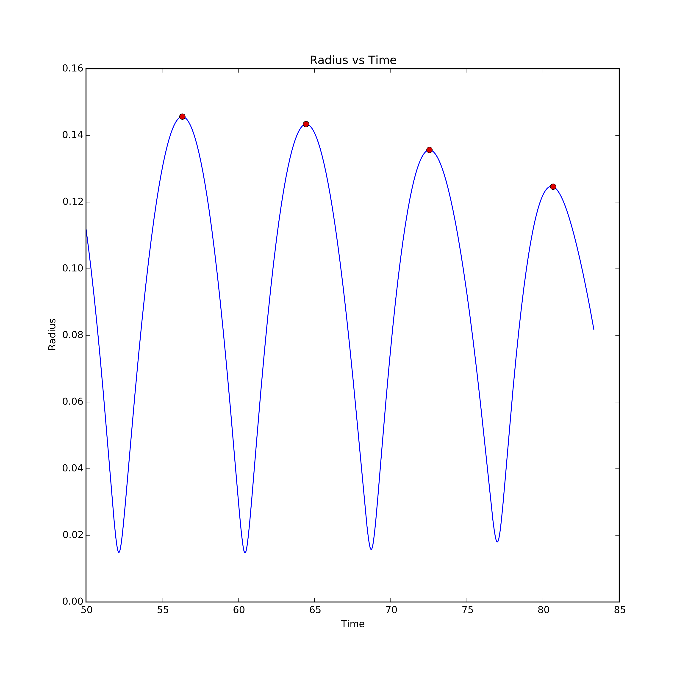
Bifurcation Diagram

Slide 13
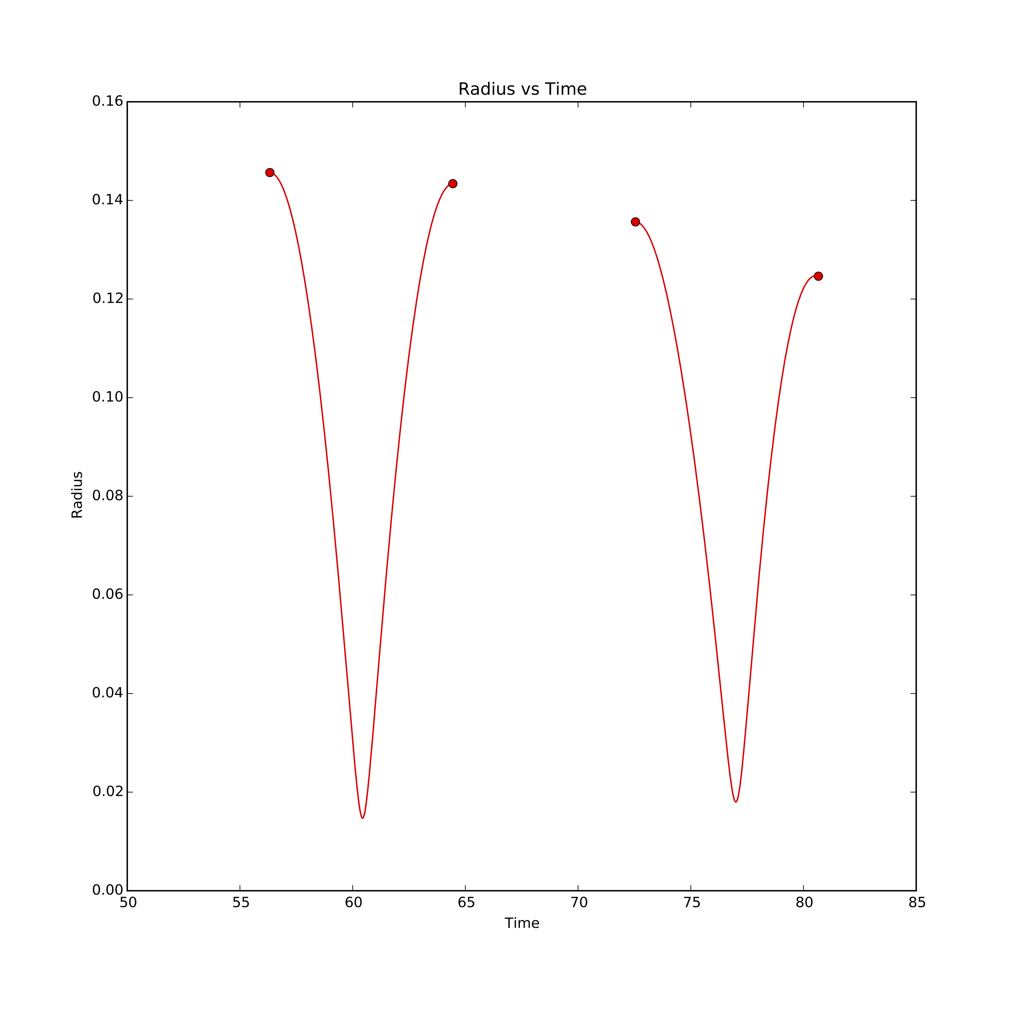
Bifurcation Diagram

Slide 14
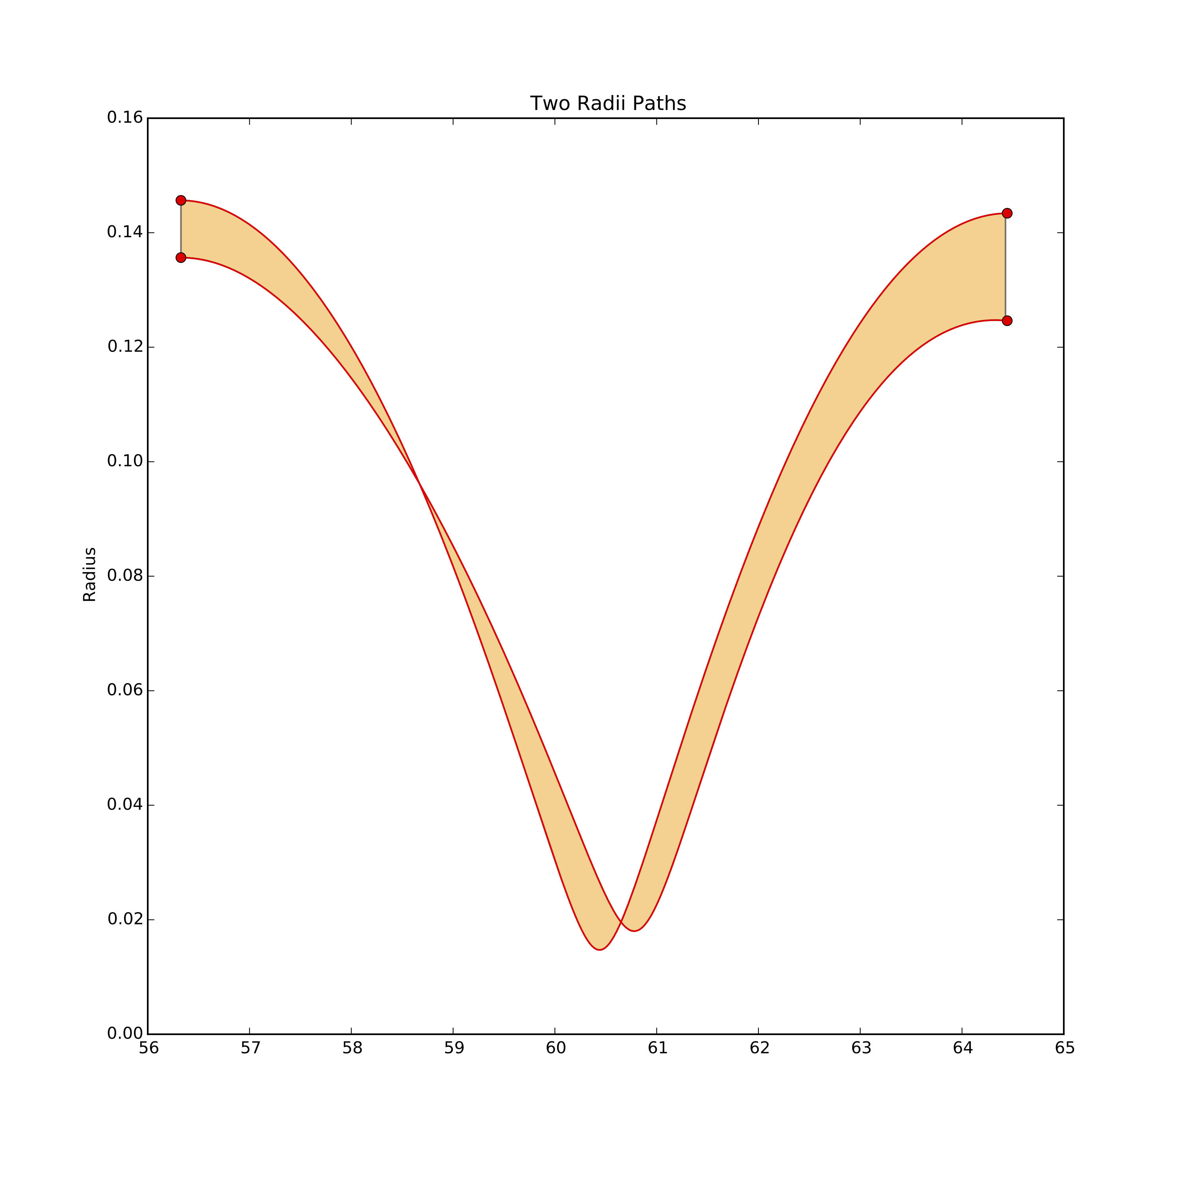
Bifurcation Diagram

Slide 15
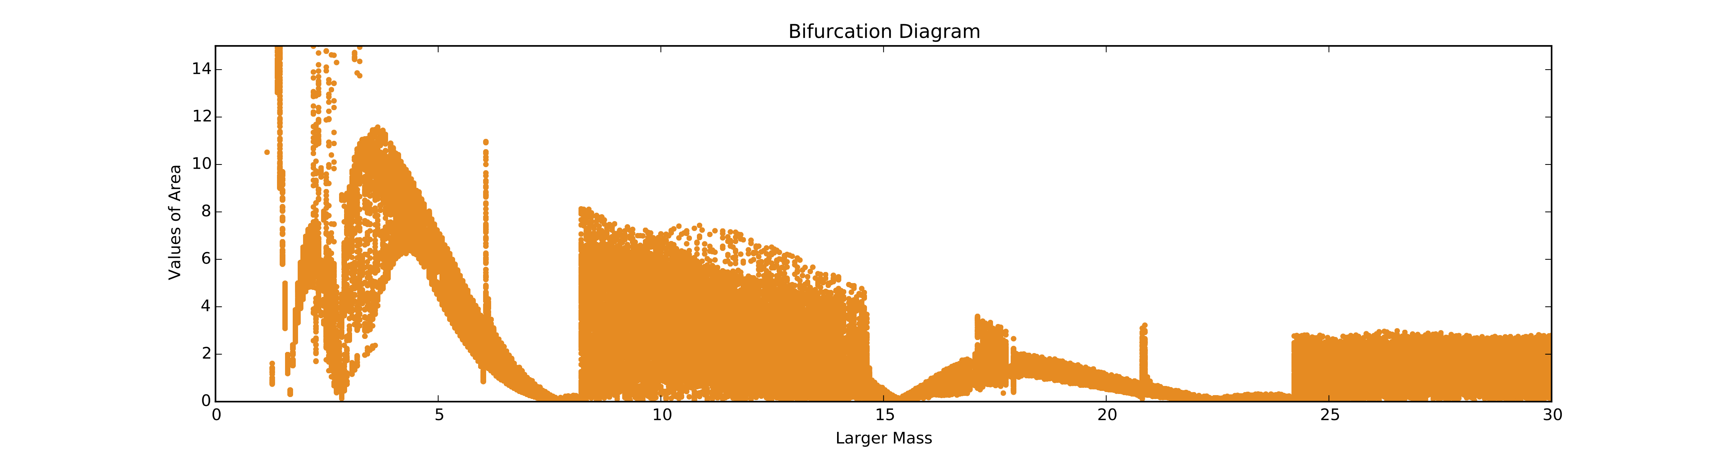
Bifurcation Diagram

Slide 16
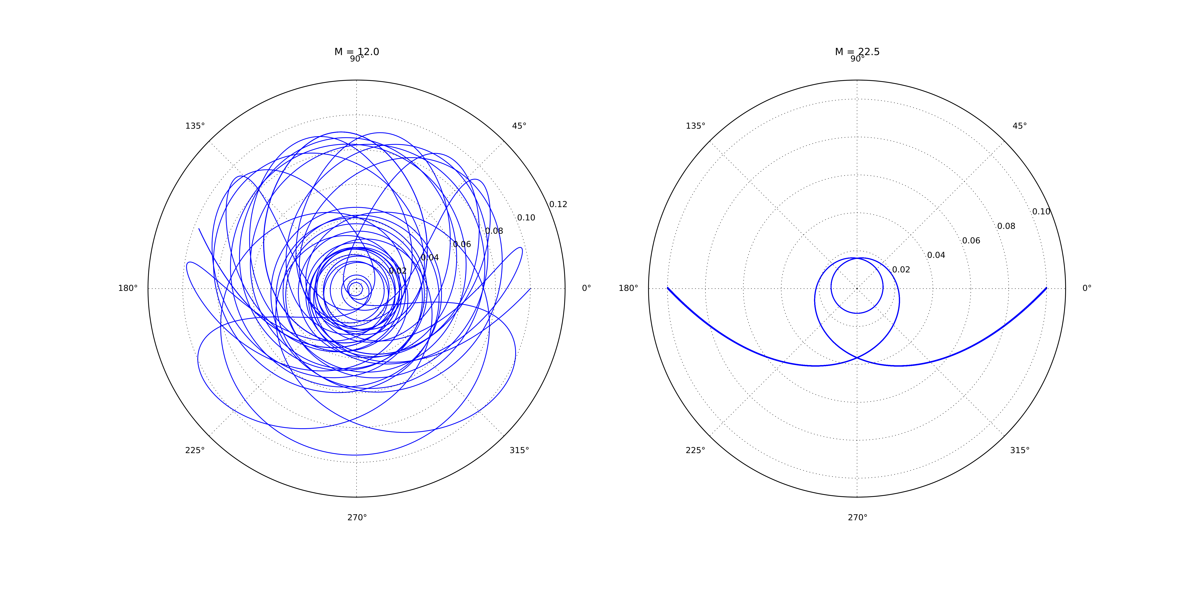
Bifurcation Diagram

Slide 17
Poincaré Maps
Plot radius, radial momentum, and angle
Find times when the angle is 0
Determine the radii and radial momenta for these times
Plot these values for various initial values

Slide 18
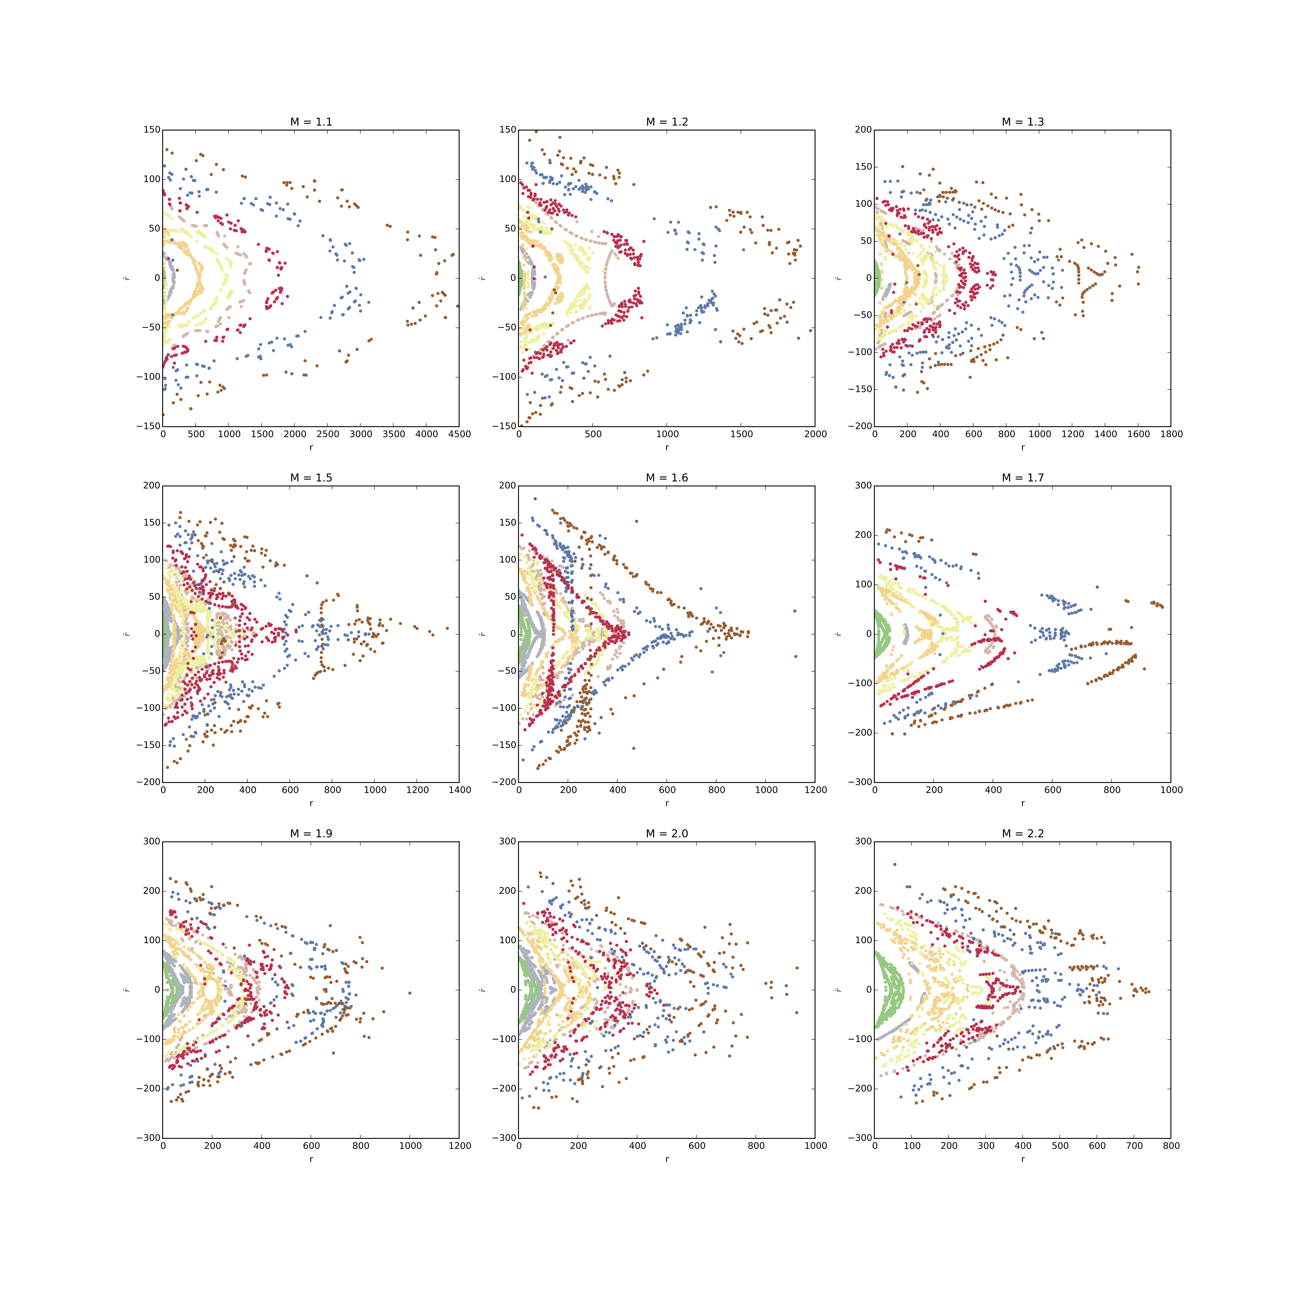

Slide 19
Expected Results and Actual Results

Slide 20
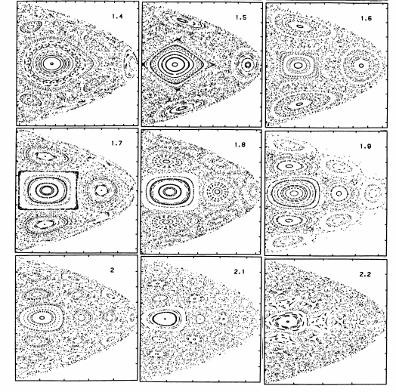
Poincare Maps

Slide 21

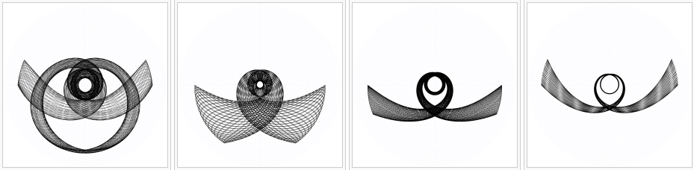
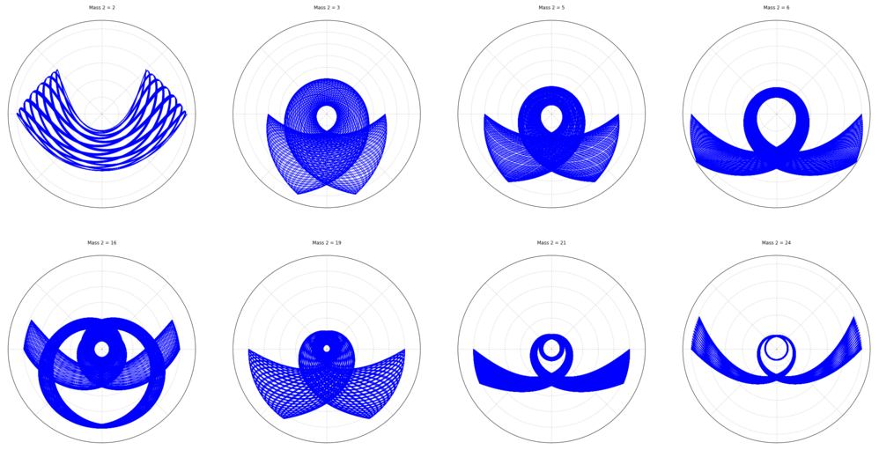
Non-singular Orbits for different masses
Expected
Actual

Slide 22
References
Antonio Politi (2013) <a href="http://www.scholarpedia.org/article Lyapunov_exponent">Lyapunov exponent</a>. <a href="http://www.scholarpedia.org/">Scholarpedia</a>, 8(3):2722.
N. Tufillaro. Motions of a swinging Atwood’s machine. Journal de Physique, 1985, 46 (9),
pp.1495-1500. <10.1051/jphys:019850046090149500>. <jpa-00210094>
Swinging Atwood's machine. (2014, June 15). In Wikipedia, The Free Encyclopedia. Retrieved 05:43, December 2, 2015, from https://en.wikipedia.org/w/index.php?title=Swinging_Atwood %27s_machine&oldid=612986832

